Slide 1

Blockchain Security Challenges and Solutions
B. RAMAMURTHY
©2025, ALL RIGHTS RESERVED
Fulbright Scholar 2025-26
Manning author: Blockchain in action
PROGRAM DIRECTOR, DATA-INTENSIVE COMPUTING PROGRAM
COURSERA INSTRUCTOR (Blockchain, DeFi)
DIRECTOR, BLOCKCHAIN THINKLAB
HTTP://WW.CSE.BUFFALO.EDU/FACULTY/BINA
COMPUTER SCIENCE AND ENGINEERING
Wallet Address (Ethereum): bina.eth
https://www.linkedin.com/in/bina-ramamurthy/

Slide 2





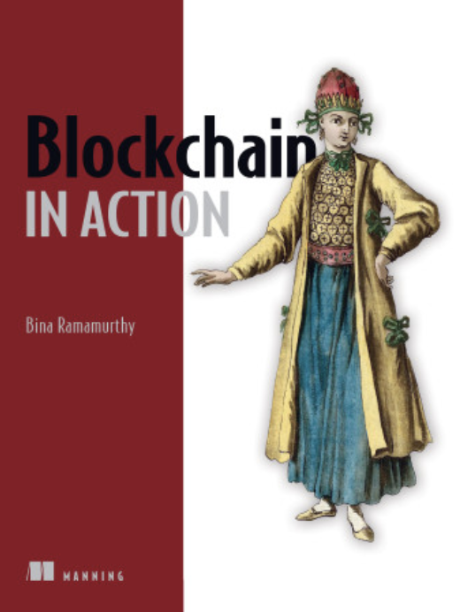
Introducing myself
Been in Buffalo, NY, USA for more than 40 years!
Ph.D. in Computer Engineering: Fault tolerance in distributed systems
Faculty at CSE and University at Buffalo (UB) for the past 3 decades
Launched a 4-courses certification on blockchain on Coursera MOOC (2018)
--More than 400,000 learners and 1,000,000 visitors from all over the world
Launched Decentralized Finance (DeFi) – a 3-course certification (2024).
Funding: National Science Foundation ((> 1 million), SUNY IITG, industrial
And private donations.
SUNY chancellor’s award for excellence in teaching 2019
IEEE Region 1 Outstanding Teacher Award (2022)
Author of a technical book: Blockchain in Action (Manning.com)
Author of Blockchain, Cryptocurrency and DeFi (World Scientific)

Slide 3


Fulbright Scholar
Now I am Fulbright Scholar at St. Polten University of Applied Science
Expanding on my deep involvement in
Blockchain, Cryptocurrency and Decentralized Applications.

Slide 4
Plan for the talk
What is a blockchain? Why should you care?
Blockchain ecosystem and its security challenges
Subset of challenges facing participants
Solutions to address these challenges
We will discuss the above items with examples.
My goal is to provide the audience of this talk with actionable takeaways from this talk.

Slide 5

Technical level of the talk
User/participant level
Application level
Code /programming level
Algorithmic /Fundamental Protocol level
However, if you have any questions do not hesitate to ask me.

Slide 6
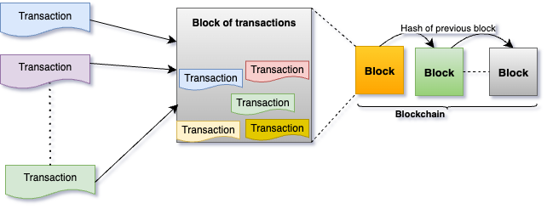
What is a blockchain? Structurally …

Slide 7
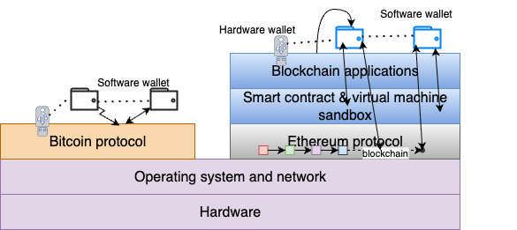
Where is it stored? Here is just one node in a blockchain network of nodes.
Bitcoin¹ and Ethereum² are two leading blockchain protocols.

Slide 8

How to establish trust? Consider Hotel check in:
You arrive at the check-in counter. Show your ID.
You show your reservation.
Then you provide your credit card.
Check-in clerk VERIFIES the ID.
Check in clerk VERIFIES the reservation by looking it up on a database or ledger.
The clerk VALIDATEs the credit card and RECORDs it in the database or the ledger for the payment.
Hands the keys and shows you to your room.
Notes:
Thie art in the powerpoint should be shown.

Slide 9
Trust Intermediation
That’s what a blockchain protocol
and distributed ledger do.
Verify
Record
Verify
Validate
Blockchain does trust intermediation…

Slide 10
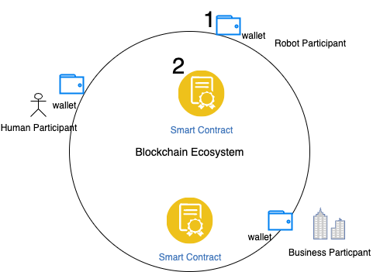
Security Risk Analysis

Slide 11
Security Challenges
Security challenges exists at various levels of the blockchain stack.
User level
Wallet level
Application level
Smart contract level
Protocol level : Consensus

Slide 12
Wallet Artifacts (software wallet)
A software wallet has cryptographically generated items called accounts, and it has a strong foundation in cryptography.
It connects to blockchain networks (recall it is portal or entry point to the blockchain networks)
It has:
Accounts: accounts identified by account numbers or decentralized identifiers (DeIDs)
Each account has a balance of cryptocurrency
User specified password to lock the wallet
Each account has underlying private key and public key (key-pair cryptography)
Secret recovery phrase to generate, regenerate and recover a wallet.

Slide 13
Blockchain Wallet Security Challenges
Here are some important practical challenges:
It is a self-custody wallet: you install it, you generate its account numbers and manage their balances.
You set the wallet password that you will have to remember and recall. There is no “central” authority that can resend the password information.
There is a secret recovery phrase (of 12 words for Ethereum) that can be used to repopulate/ regenerate the wallet if you forget the password.
Wallet has the private keys of the accounts, and these keys must be secured. If you give away the private key of an account, the account may be compromised.
39% of fraudulent loss³ is due to phishing attacks for private keys or recovery phrase.

Slide 14
Wallet security Solutions
Now you have/know about 4 items of a wallet: account number, password, secret recovery phrase, and private keys.
You can give the account number to anyone if they need it. This may be to transact with you.
You set the password, and do not give way the password. If you forget the password to a wallet, you can “regenerate” the wallet using secret recovery phrase and reset a new password. But if you cannot recall the secret recovery phrase, your wallet and its contents are lost forever.
Secret recovery phrase is an inherent and defining property of a wallet. Created cryptographically. Do not give away to anybody or embed the secret key phrase in code.

Slide 15
Wallet Security
You as a decentralized participant is responsible for the security of the ”password” , “secret recovery phrase” and the “private keys”.
And “self-custody” of these wallet artifacts.
For the security of the wallet do not reveal these items to others.
Here is my crypto wallet that I have using since 2017. My DeID is 0x3e6937bb87A66E3A4DbE5488A4863f5b29674cC3 and on Ethereum Namespace (ENS): bina.eth

Slide 16
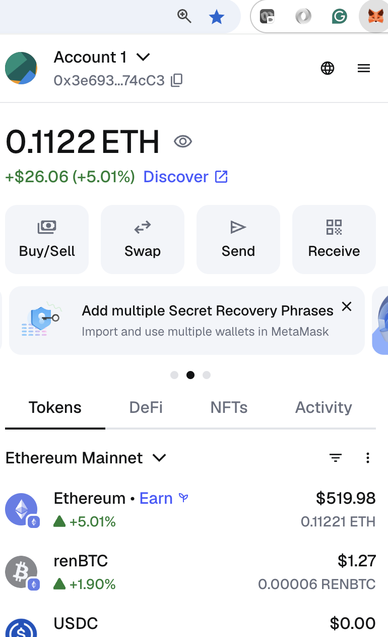
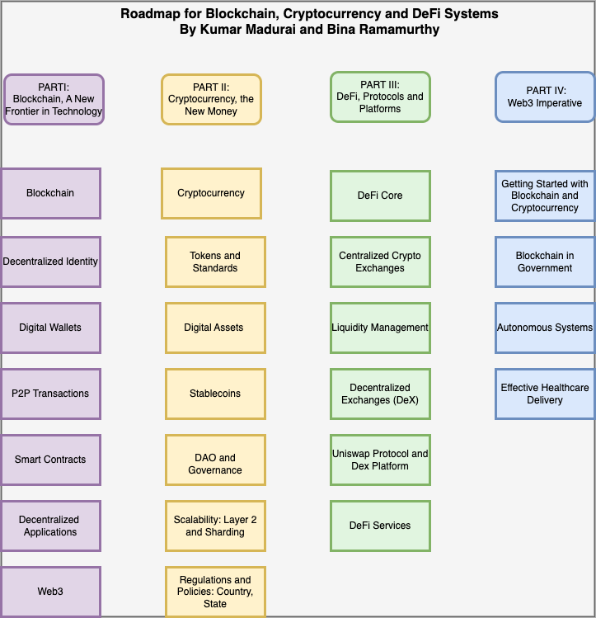
Sample Wallet
I have a full chapter describing wallet details in my recent book: Blockchain, Cryptocurrency, and Decentralized Finance^{4.}

Slide 17
Blockchain Smart Contract Security Challenges
Securing a smart contract is much more complex.
Let’s begin by understanding what is a smart contract.
It is a piece of code: The format of the code is in object-oriented class and is called “contract”.
A smart contract class defines (i) data and (ii) functions.
It is NOT compute-intensive code: but it codifies policies and rules.
So, it is a gatekeeper, whereas a wallet is a gate!
It is the “brain” or the “control center” of blockchain applications.
Challenge: it is a piece of code: it can have bugs like any other code, it can be written to be malicious, it can result in “rug pulls”. It is immutable once deployed.
So how to address smart contract security problem?

Slide 18
Smart contract Security Solutions
Code only what is needed – lean coding techniques.
No dynamic or large data structures. …
Smart contract has an address and can hold cryptocurrency balance and transfer it.
Focus on secure coding practices.
Security audits of smart contract help in checking the code if it does what it is expected to do. This is a big industry now.
Especially, Check the crypto transfer functions and policies controlling it.

Slide 19
Summary
We learned about the blockchain structure and purpose and functions.
We reviewed security from a participant point of view: at a high level.
We examined wallet level, application level and smart control level security.
We touched upon protocol level security with consensus algorithm.
Depending on the level of the blockchain stack you are interested in, please explore the references provided.
Understanding how to secure their wallets, participate in network decisions, and protect their digital assets.

Slide 20
References
S. Nakamoto, Bitcoin: A Peer-to-Peer Electronic Cash System, https://bitcoin.org/bitcoin.pdf, 2008.
https://www.bankless.com/read/the-secs-project-crypto-is-uniquely-bullish-ethereum
https://www.certik.com/resources/blog/hack3d-the-web3-security-report-2024
B. Ramamurthy and K. Madurai. (2025). World Scientific Publishers. https://www.worldscientific.com/worldscibooks/10.1142/12818
B. Ramamurthy.(2020) Blockchain in Action, Manning Publications.

